Slide 1

Predicting Material Backorders In Inventory Management
Project Guide:
Dr. B. Rajeswari, Associate Professor,
DMS, Pondicherry University
By
RAMESH KUMAR M (21401031)
21401031@pondiuni.ac.in

Slide 2

01
Company Overview
Contents
02
Objective
03
Dataset
04
EDA & Feature Engineering
05
Model Building
06
Model Deployment
07
Conclusion

Slide 3

01 - Company Overview
Technocolabs is an Indore, Madhya Pradesh based Start-up company. The company was established in 2019. The primary area of focus of the company is Machine Learning, Data Science and Artificial Intelligence based product development.
The Chief Executive Officer of Technocolabs is Mr. Yasin Shah. The technologies that they utilise are Django, Heroku, Java, Node JS, JS, Python, C, C++, C#, Android, React, SwiftUI, VUE.js, Angular, CSS and GIT.
The services that they are offer are in the domain of Machine Learning, Computer Vision, Mobile Application Development, Voice enabled Skills, Web Application Development, Big Data and Data Science.
https://technocolabs.com/

Slide 4
02 - OBJECTIVE
Primary:
The goal is to minimize backorders by identifying the material at risk of backorder before the event occurs.
This gives the business management a suitable time to react and make appropriate changes.
The major contributions of this project are stated as follows:
To compare the different learning classiﬁers algorithms, based on speciﬁc techniques to tackle the class im-balanced problem, such as sampling and ensembles of classiﬁers;
To provide a common framework for model development, testing and evaluation, in the considered detection system design;

Slide 5
03 - Dataset
The Secondary data which is provided by Technocolabs Softwares Inc.
TABLE II
DATASET SUMMARY
Dataset | #Atts | #Pos. | #Neg. | #Total | Imb. Ratio
bopredict | 23 | 13,981 | 1,915,954 | 1,929,936 | 1:137

Slide 6
03 - Dataset
The dataset has the following columns:
sku: Stock Keeping Unit;
national_inv: Current inventory level of component;
lead_time: Registered transit time;
in_transit_qty: In transit quantity;
forecast_3_month: Forecast sales for the next 3 months;
forecast_6_month: Forecast sales for the next 6 months;
forecast_9_month: Forecast sales for the next 9 months;
sales_1_month: Sales quantity for the prior 1 month;
sales_3_month: Sales quantity for the prior 3 months;
sales_6_month: Sales quantity for the prior 6 months;
sales_9_month: Sales quantity for the prior 9 months;
min_bank: Minimum recommended amount in stock;
potential_issue: Indictor variable noting potential issue with item;
pieces_past_due: Parts overdue from source;
perf_6_month_avg: Source performance in last 6 months;
perf_12_month_avg: Source performance in last 12 months;
local_bo_qty: Amount of stock orders overdue;
deck_risk: General risk flag;
oe_constraint: General risk flag;
ppap_risk: General risk flag;
stop_auto_buy: General risk flag;
rev_stop: General risk flag;
went_on_backorder: Product went on backorder

Slide 7
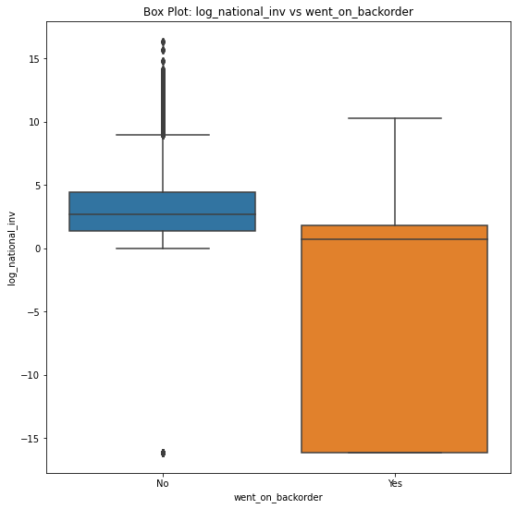
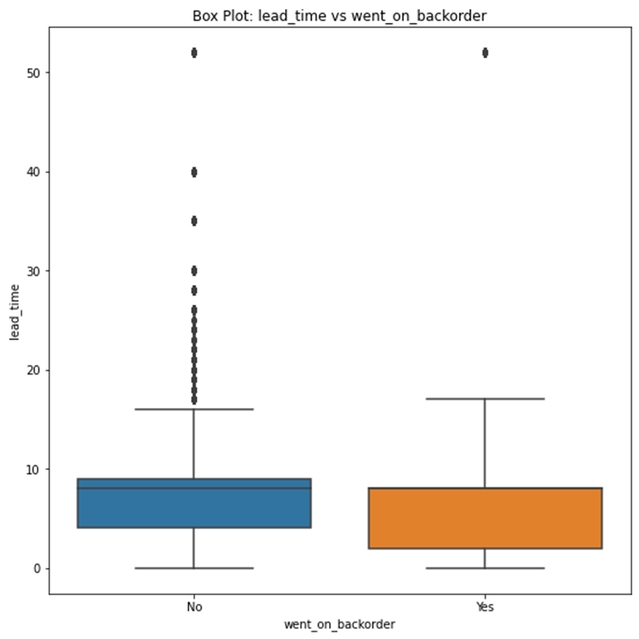
04 - Exploratory Data Analysis
1. national_inv vs went_on_backorder
2. lead_time vs went_on_backorder

Slide 8
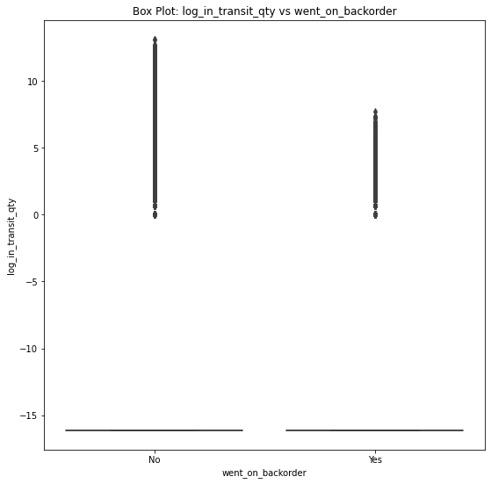
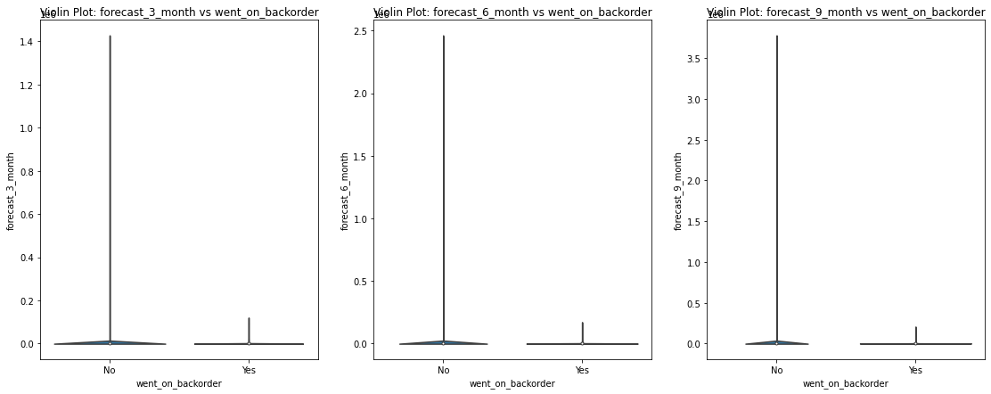
04 - Exploratory Data Analysis
3. in_transit_qty vs went_on_backorder
4. forecast_3_month, forecast_6_month and forecast_9_month vs went_on_backorder

Slide 9
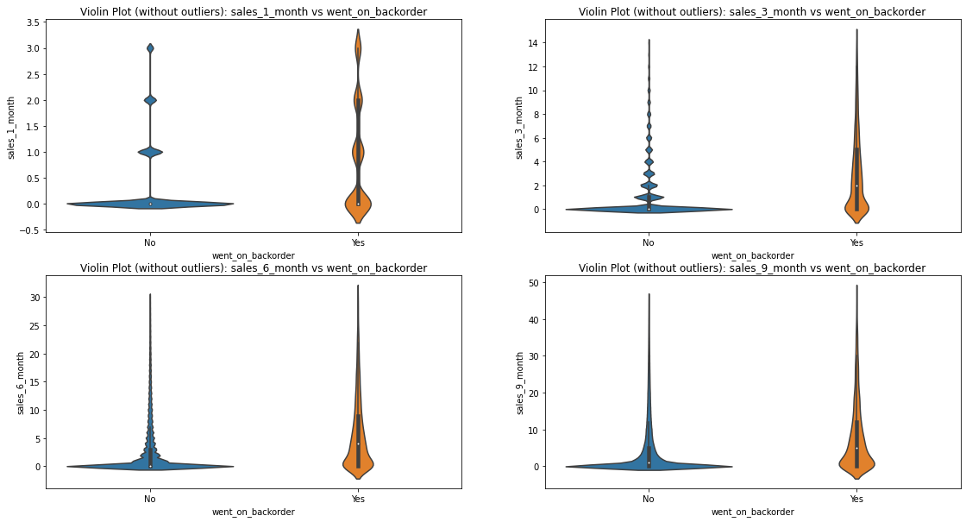
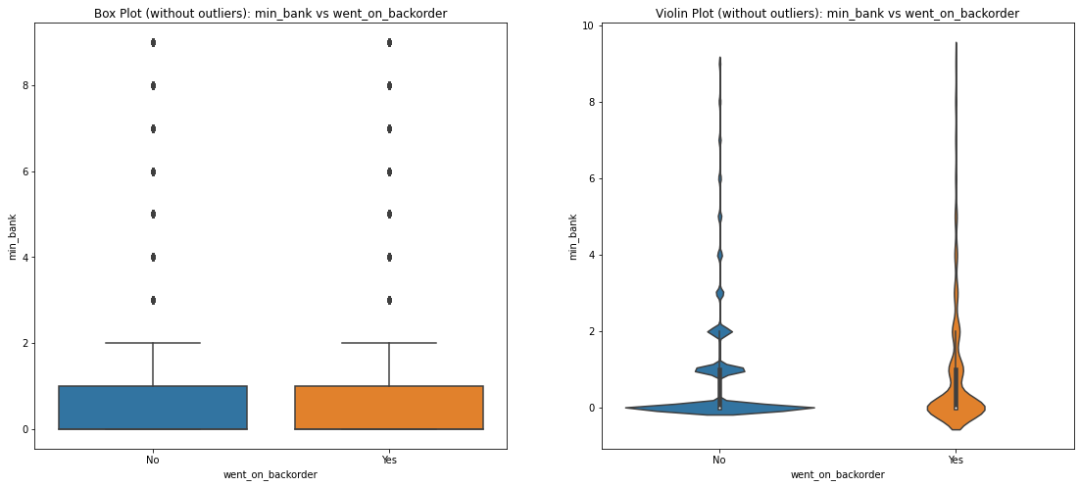
04 - Exploratory Data Analysis
5. sales_1_month, sales_3_month, sales_6_month and sales_9_month vs went_on_backorder
6. min_bank vs went_on_backorder

Slide 10
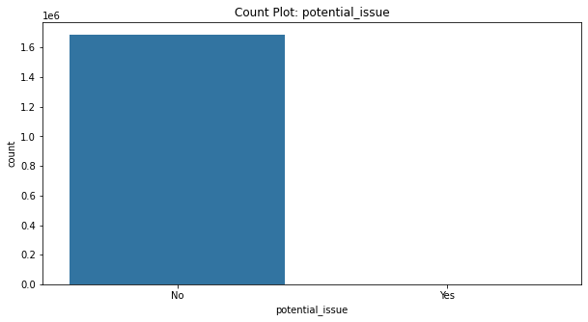
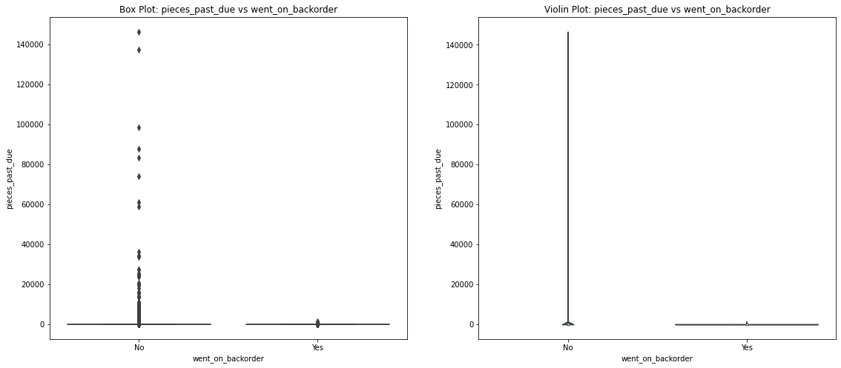
04 - Exploratory Data Analysis
7. potential_issue vs went_on_backorder
8. pieces_past_due vs went_on_backorder

Slide 11
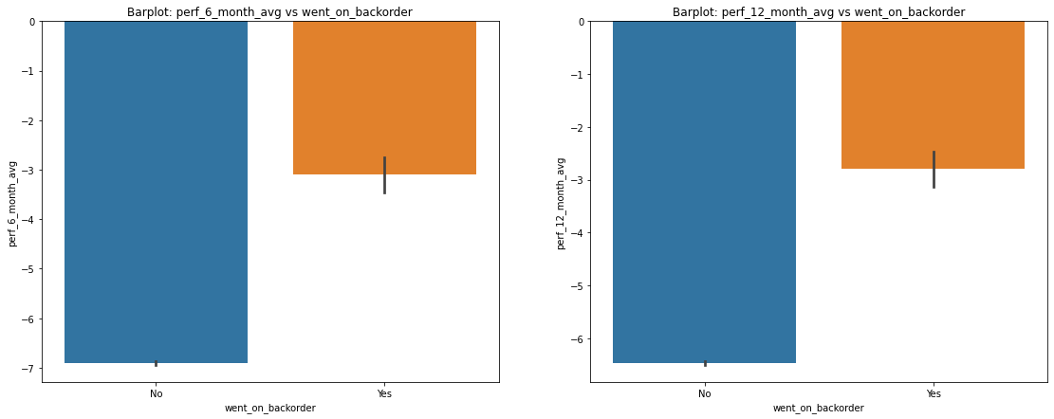
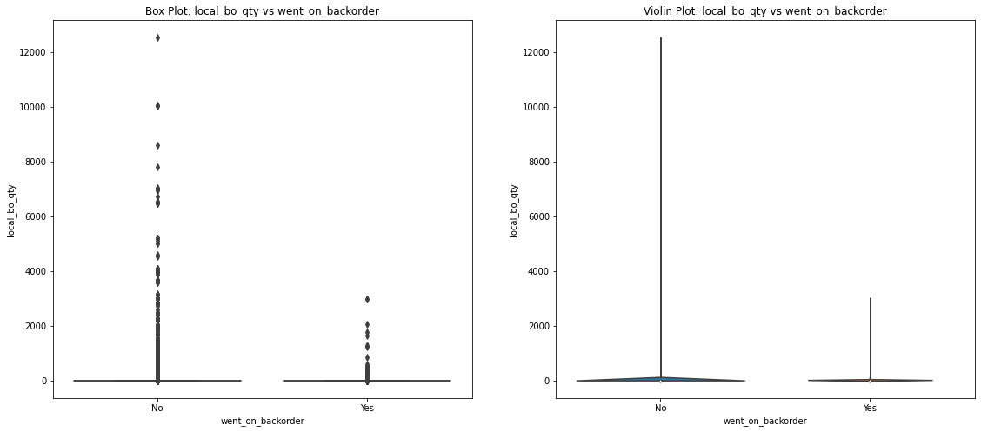
04 - Exploratory Data Analysis
9. perf_6_month_avg and perf_12_month_avg vs went_on_backorder
10. local_bo_qty vs went_on_backorder

Slide 12
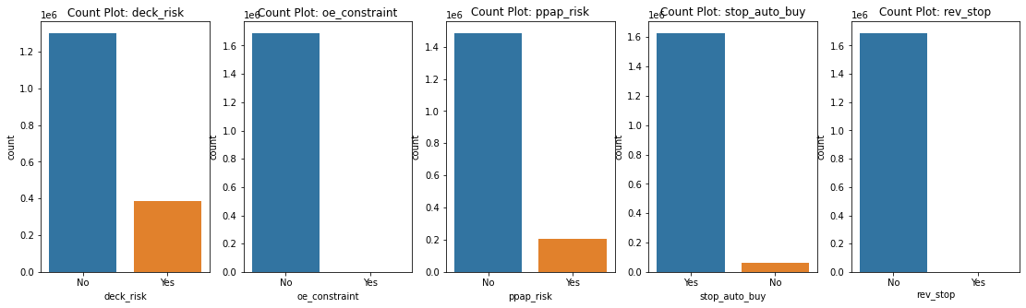
04 - Exploratory Data Analysis
11. deck_risk, oe_constraint, ppap_risk, stop_auto_buy and rev_stop vs went_on_backorder

Slide 13
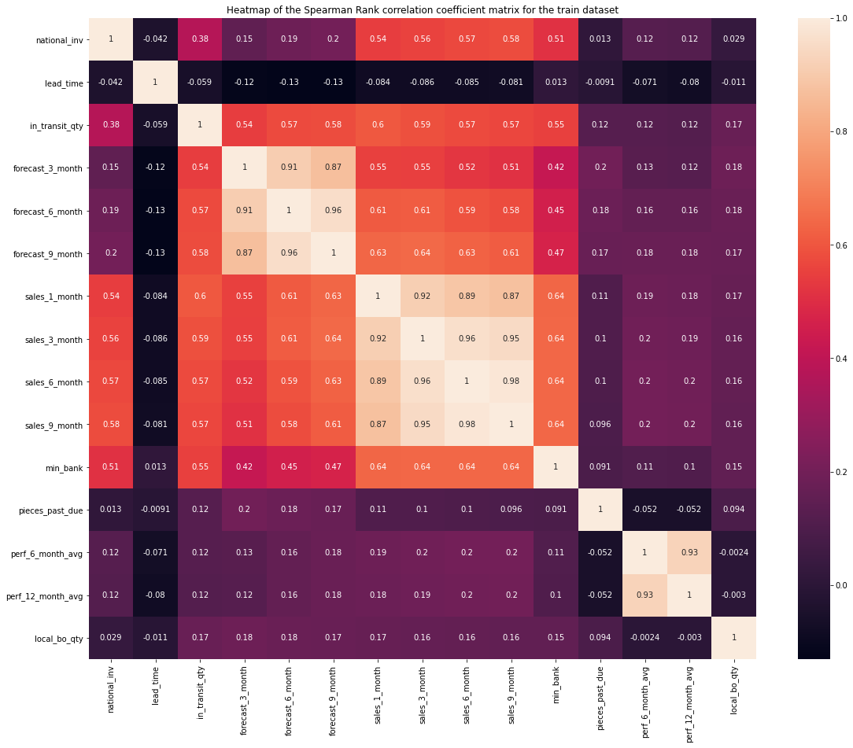
Spearman Rank Correlation Coefficient
Here, the heatmaps of spearman rank correlation coefficient have been plotted. It shows that the 'in_transit_qty', 'forecast_3_month', 'forecast_6_month', 'forecast_9_month', 'sales_1_month', 'sales_3_month', 'sales_6_month', 'sales_9_month' and 'min_bank' are highly correlated with each other. Among them, 'forecast_3_month', 'forecast_6_month' and 'forecast_9_month' are more correlated with each other compared to the rest. Similarly, 'sales_1_month', 'sales_3_month', 'sales_6_month' and 'sales_9_month' are more correlated with each other than any other feature. Furthermore, it shows that the 'perf_6_month_avg' and 'perf_12_month_avg' are highly correlated with each other.

Slide 14
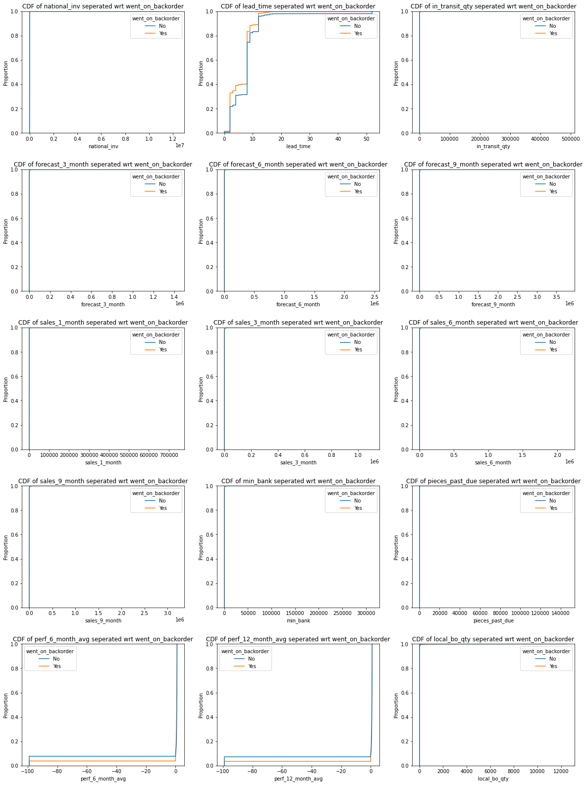
Kolmogorov–Smirnov test for numerical features
It is clearly shows that most of the feature have very high number of datapoints at 0. From the KS test for all the numerical feature we can say most of the features do not have a very good p values and thus the null hypothesis has to be rejected. Therefore, these distributions are not similar are do not show much correlation with the target variable.
However, some features like lead_time, perf_6_month_avg, perf_12_month_avg show good enough correlation with the target variable.

Slide 15
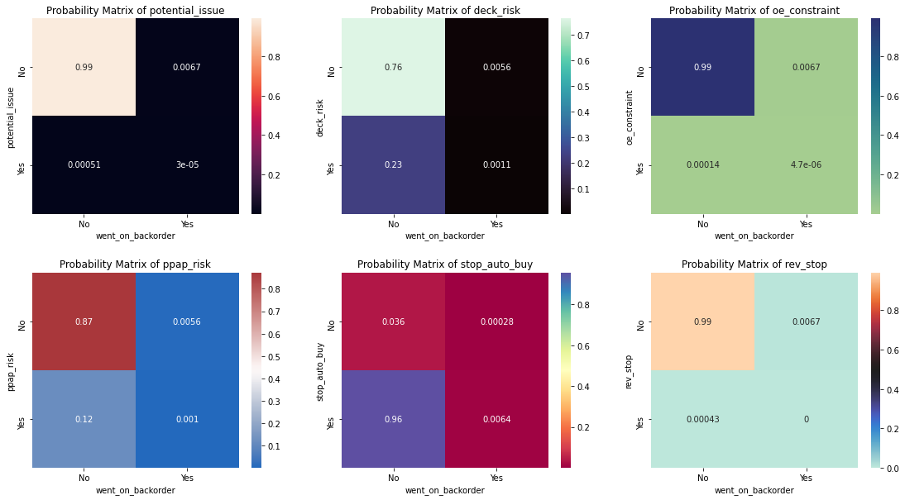
Stochastic/Probability Matrix for categorical features
From the set of probability matrices for all the categorical features, it shows that most of these categorical features have a very high probability of having a negative flag when the product did not go into backorder. Therefore, it says that when a product does not go into backorder, most of the general risk flag are negative.

Slide 16
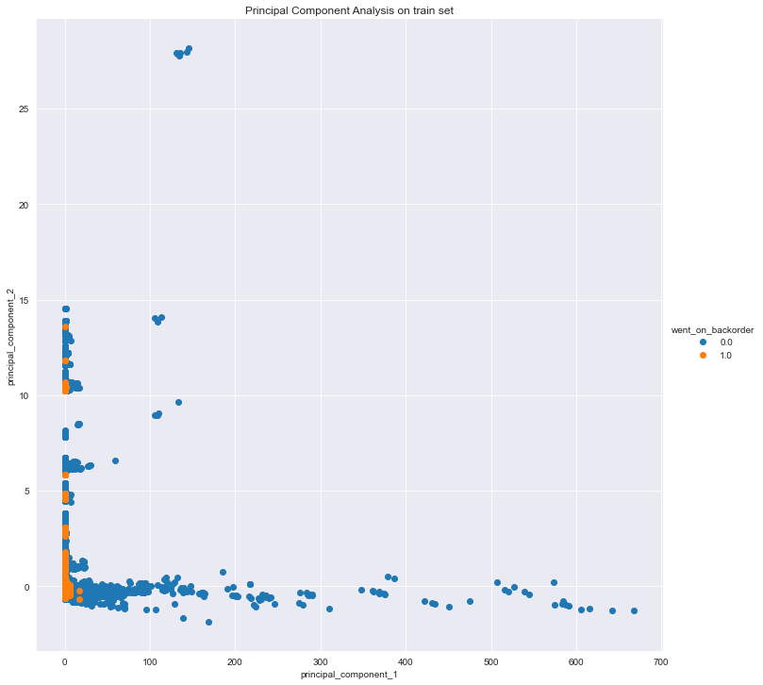
Dimensionality Reduction
Dimensionality reduction techniques is used, in this case Principal Component Analysis to capture the essence of the data.
From the plot, it shows that most of the datapoints lie alongside 0. This deduction is true because many features with mostly 0 values in our EDA.
There are outliers in the data but those datapoints does not have to be outlier per se. Furthermore, these potential outliers are more of the negative class compared to the positive class. And, for the positive class, almost all of the datapoints lie alongside 0.

Slide 17
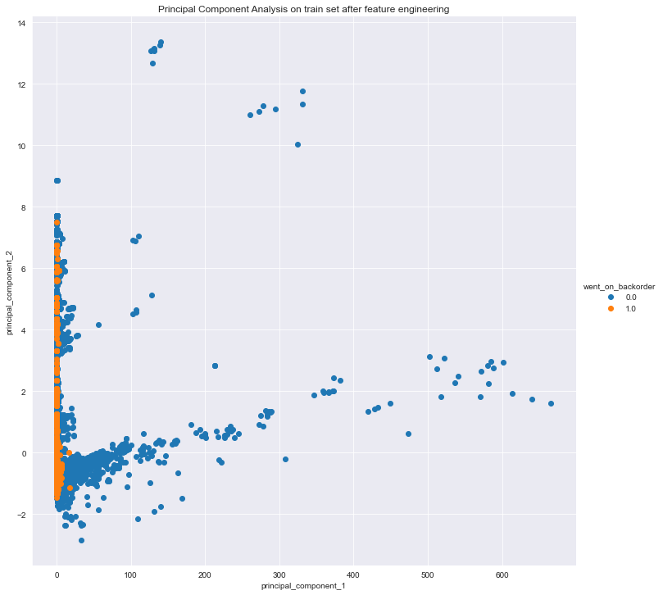
04 - Feature Engineering
Mean imputations for the feature lead_time have been performed. Furthermore, it showed that the feature pieces_past_due and local_bo_quantity has more than 95% of values as 0. Therefore, as a feature engineering process, add another feature which shows if each datapoint in the two features is zero or non-zero.
Two new features have been added which show us if the datapoint in pieces_past_due and local_bo_quantity is a zero value or a non-zero value respectively. For further feature engineering, impute the zero values in all categorical features with the respective probability values from the probability matrices we calculated above.
It shows some separation and also overlap between the positive class and the negative class. This means that the model we build should be able to fairly distinguish between a product that went backorder versus a product that did not go into backorder.
The final dataset which will be used to build a machine learning model, where the column 'went_on_backorder' is our target label.

Slide 18
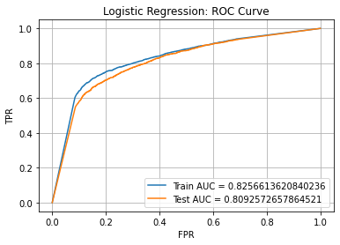
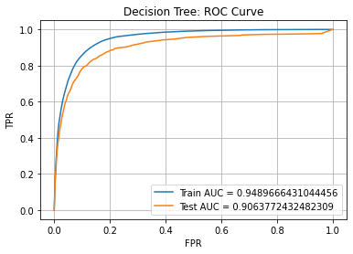
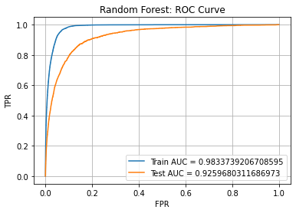
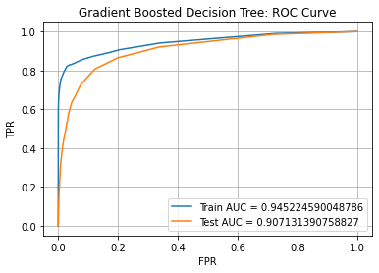
05 - Model Building

Slide 19
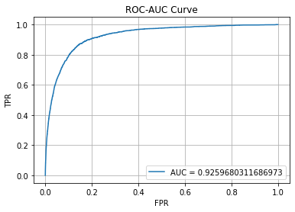
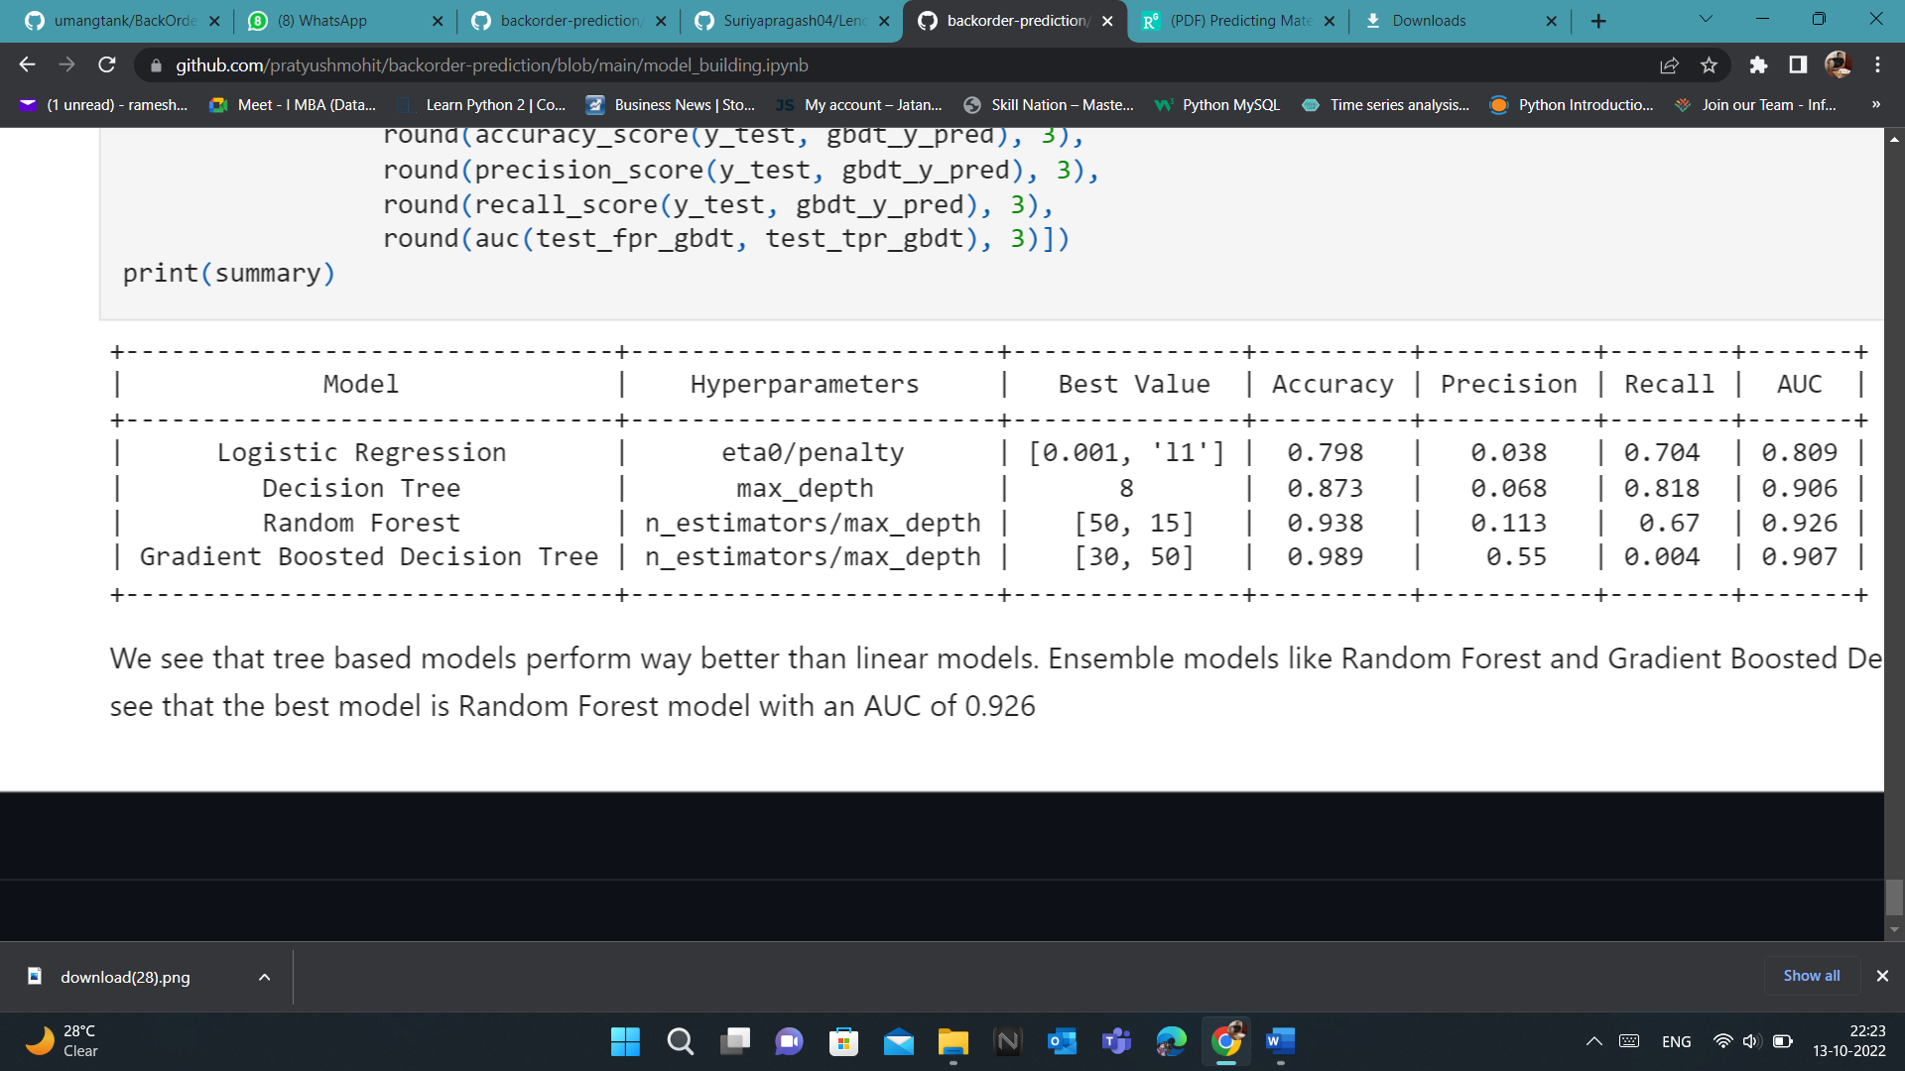
Best Model
It shows that tree-based models perform way better than linear models. Ensemble models like Random Forest and Gradient Boosted Decision Trees performed the best. It shows that the best model is Random Forest model with an AUC of 0.926
Accuracy: 0.9381927088712176
AUC: 0.9259680311686973

Slide 20
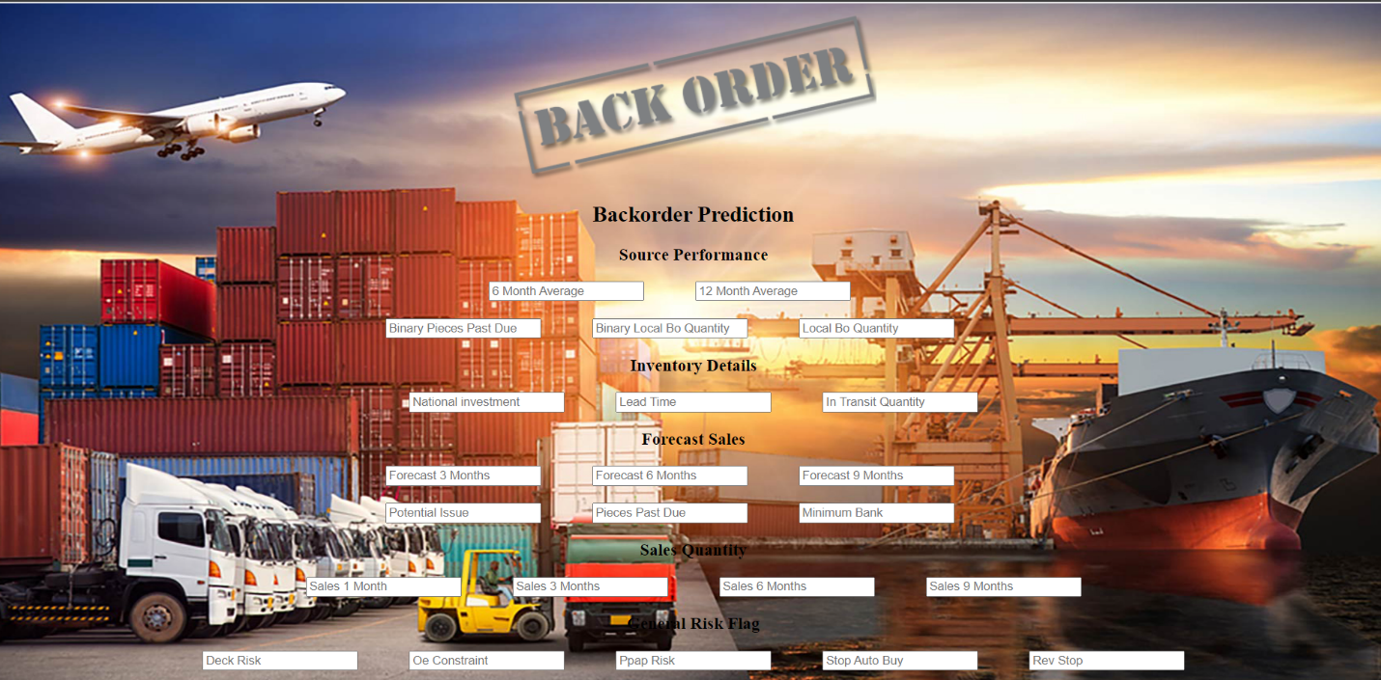
06 - Model Deployment
Link: Backorder prediction

Slide 21
07 - Conclusion
The current project presented the results of machine learning classiﬁers application within a predictive system design for inventory control, in extension of inventory planning models customarily discussed in literature.
A company’s overall service level can be extent by adopting a system such as this.
Since the items which goes on backorder (positive class) are rare compared to items which does not (negative class), some particular methods and metrics are employed either in design, development, and evaluation of the models in the considered imbalanced class problem. RANDOM FOREST has shown the best AUC score, although GBOOST performed preferably when taking into account precision-recall curves, computational costs, and enhancement capability.

Slide 22
THANK YOU
Ramesh kumar M (21401031)
21401031@pondiuni.ac.in

